Slide 1
PARTNERSHIP OPPORTUNITIES
2018 LEAGUE CHAMPIONS!
NORTH VANCOUVER WOLF PACK
2022 - 2023

Slide 2
- TABLE OF CONTENTS -
CONTACT 3
ABOUT US 4
OUR HOME 5
UNIFORM BRANDING 6
PRINT BRANDING 8
WOLF PACK GAME DAYS 10
DIGITAL BRANDING 13
WEBSITE / BROADCAST 16
OTHER OPPORTUNITIES 18
WHY PARTNER WITH US? 21
DISCLAIMER 22

Slide 3
CONTACT
GIANCARLO NADEAU
DIRECTOR OF MEDIA RELATIONS / MARKETING
wolfpackbroadcasting26@gmail.com
604-908-5867
MATT SAMSON
HEAD COACH / MANAGER
matt@northvanwolfpack.com
604-418-5588

Slide 4
ABOUT US
THE NORTH VANCOUVER WOLF PACK ARE A JUNIOR ‘B’ HOCKEY TEAM AND
PROUD MEMBERS OF THE PJHL
WINS
ONLY TEAM TO DO THAT IN A SINGLE SEASON
- 2018/2019 -
CHAMPIONS
- 2015, 2018 -
FINALISTS
- 2018 -
AFFILIATED
- THREE CURRENT PLAYERS + ALUMNI -
WE ARE COMMITTED TO CREATING A FIRST-CLASS ORGANIZATION AND A WINNING CULTURE FOR OUR PLAYERS. WE PRIDE OURSELVES IN DEVELOPING SUCCESSFUL HOCKEY PLAYERS AND SUCCESSFUL YOUNG MEN. OUR GOAL IS TO BECOME THE HIGHEST PROFILE SPORTS FRANCHISE ON THE NORTH SHORE AND THE MOST SOUGHT-AFTER TEAM TO PLAY FOR IN THE PACIFIC JUNIOR HOCKEY LEAGUE (PJHL).

Slide 5
OUR HOME
PROUD MEMBER OF:
Harry Jerome Rec Centre
Centrally located on the North Shore
1200 people capacity
Our home since 2012

Slide 6
UNIFORM BRANDING

Slide 7
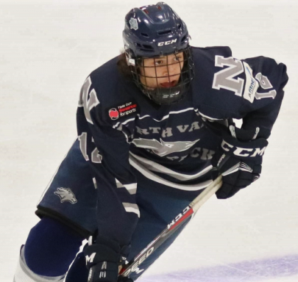
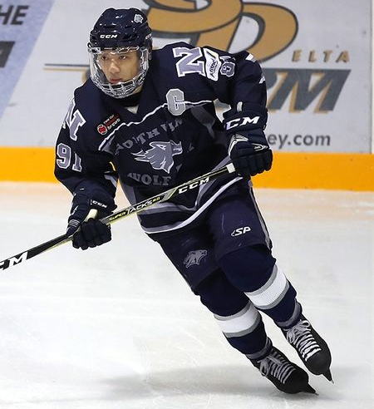
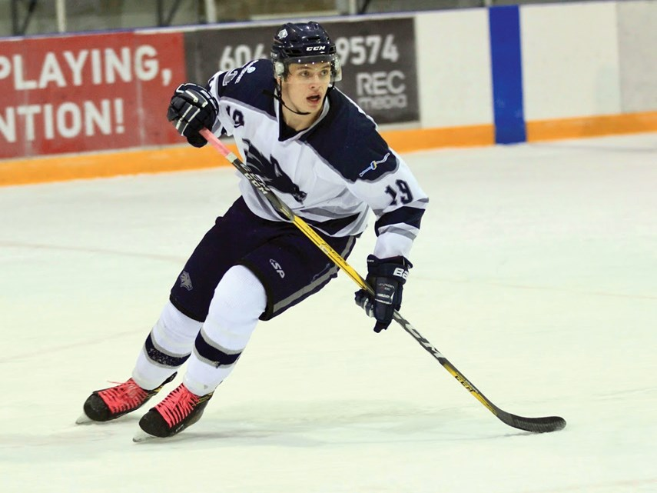
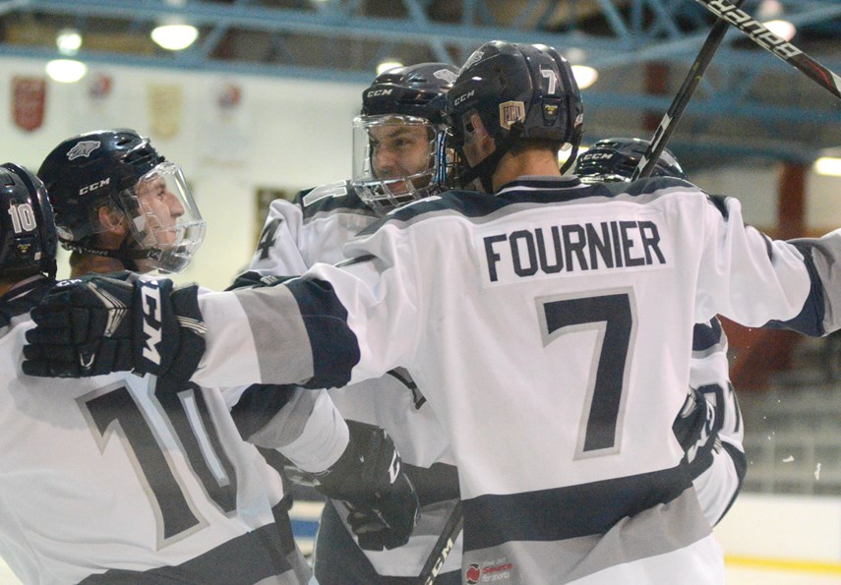
UNIFORM BRANDING
JERSEY PATCH (FRONT)
$2000
HELMET DECAL
$1500
PANT SHELLS
$2000
JERSEY PATCH (BACK)
$3500
DECAL LOCATION CUSTOMIZABLE. INQUIRE FOR DETAILS.
UNIFORM BRANDING IS FOR BOTH HOME AND AWAY UNIFORMS.
CONTACT US FOR MORE DETAILS!

Slide 8
PRINT BRANDING

Slide 9
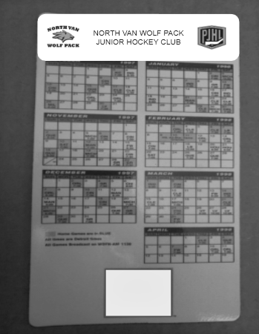
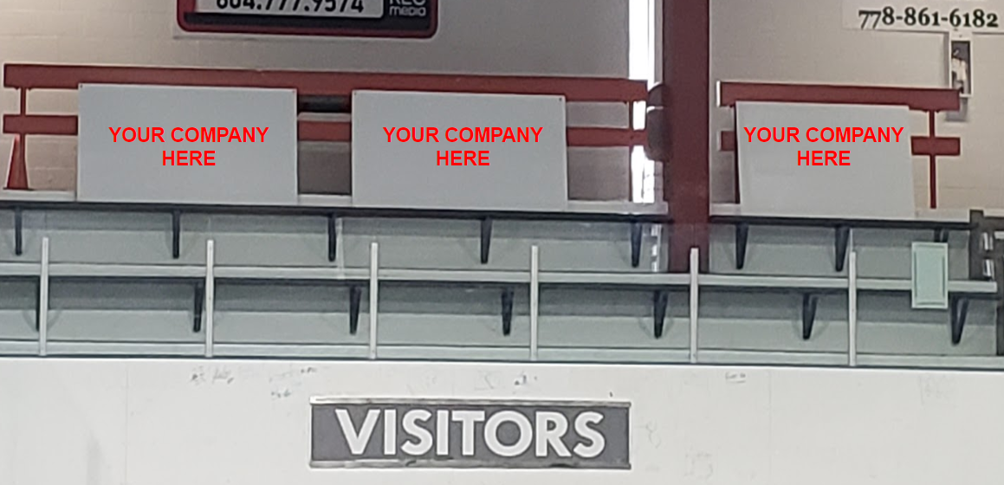
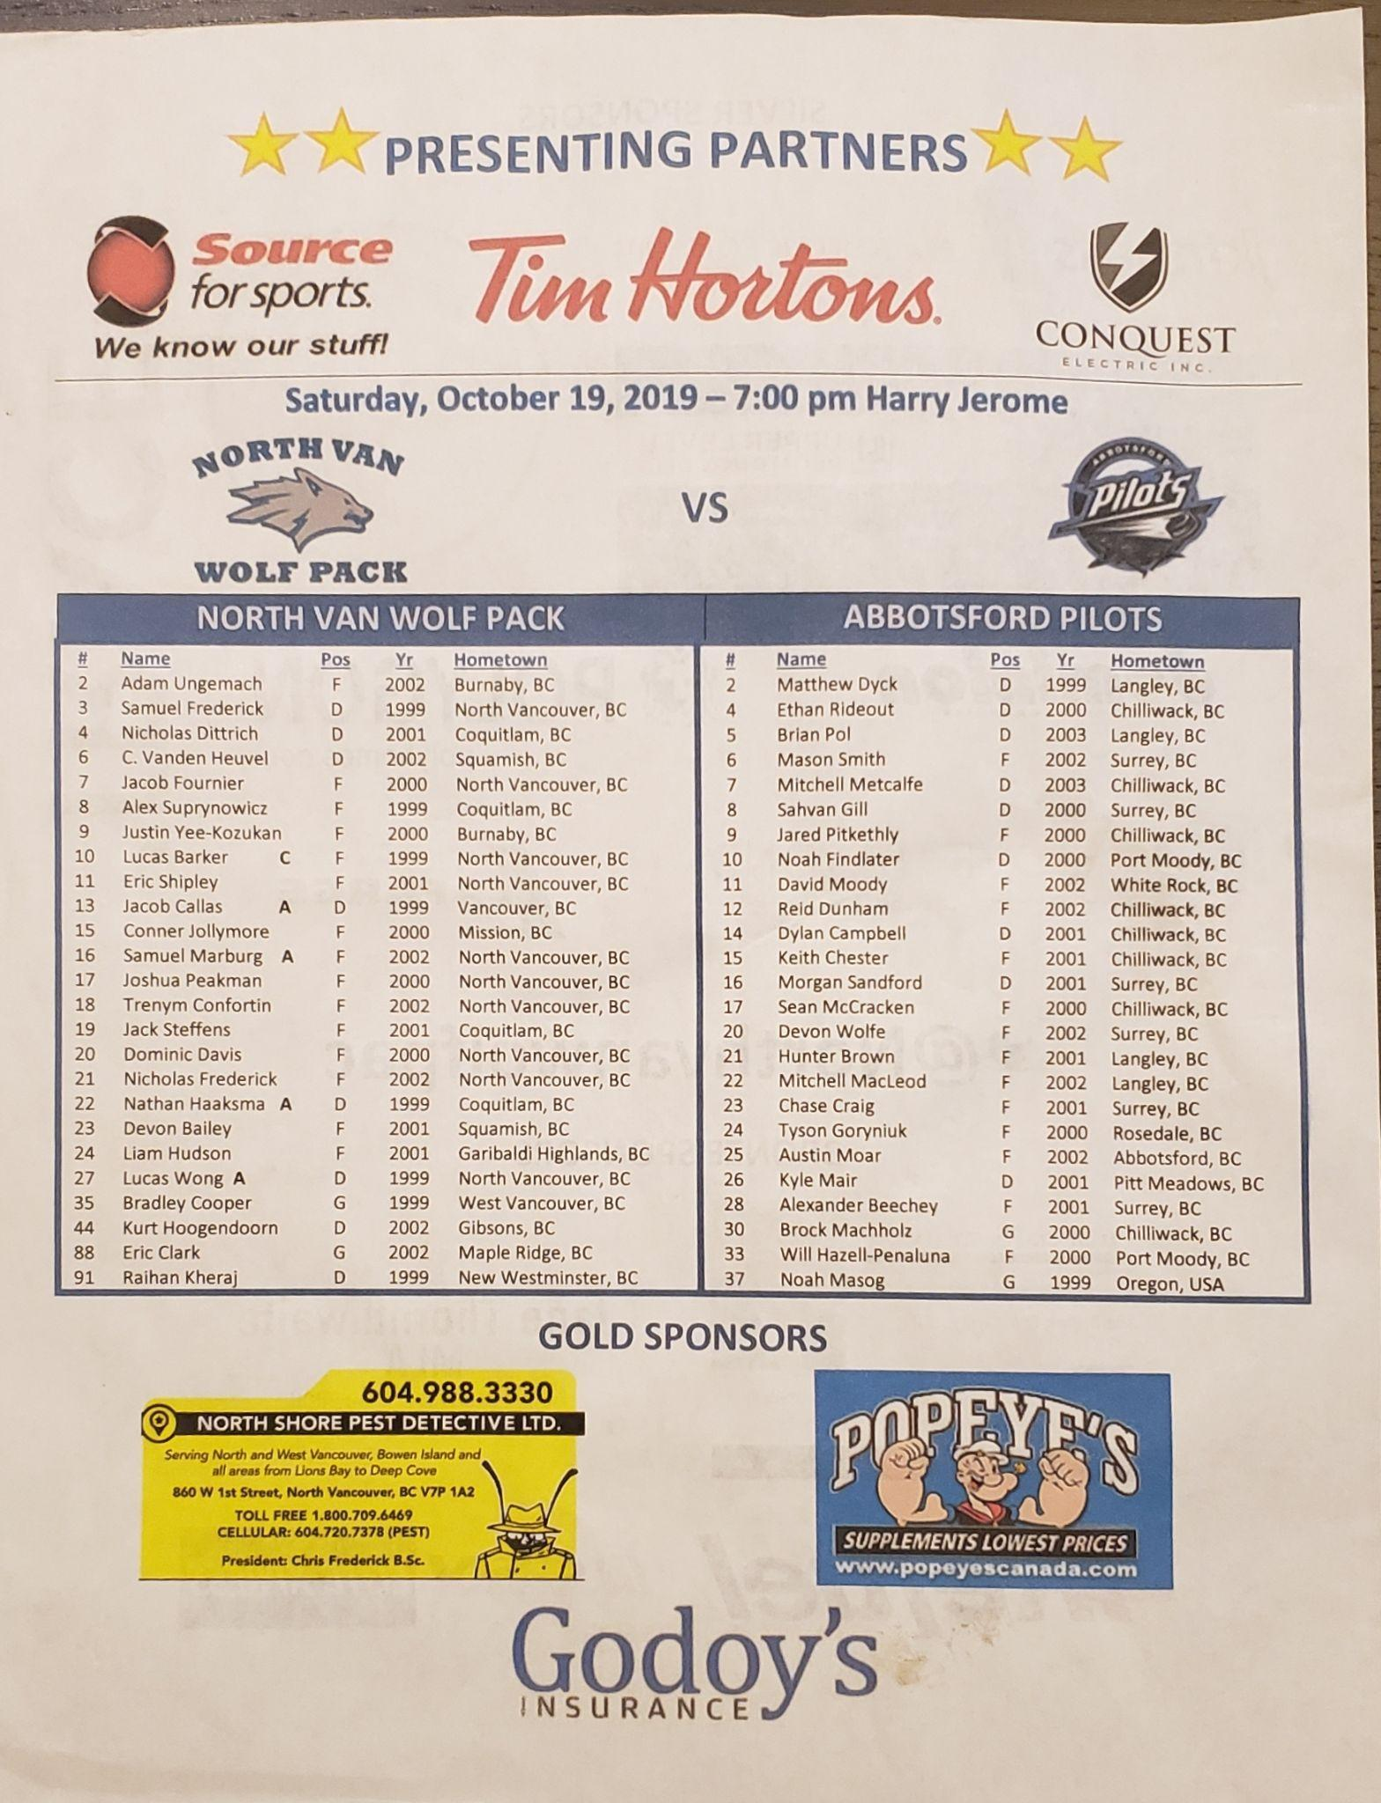
PRINT BRANDING
YOUR
COMPANY
HERE
COMPANY
AD
HERE
YOUR
COMPANY
HERE
MAGNETIC CALENDAR
$1000
COMPANY ARENA SIGN
$1250
GAME DAY PROGRAM AD
$500
Company logo printed on all magnetic calendars for
regular season.
3’’ X 5’’ arena sign with company advertisement displayed at all home games.
Company logo displayed on
all home game day programs
for the season.
CONTACT US FOR MORE DETAILS!
Notes:
MAGNETIC CALENDARS: K&J Magnetics - Custom Magnet Request Form (kjmagnetics.com)

Slide 10
WOLF PACK GAME DAYS

Slide 11
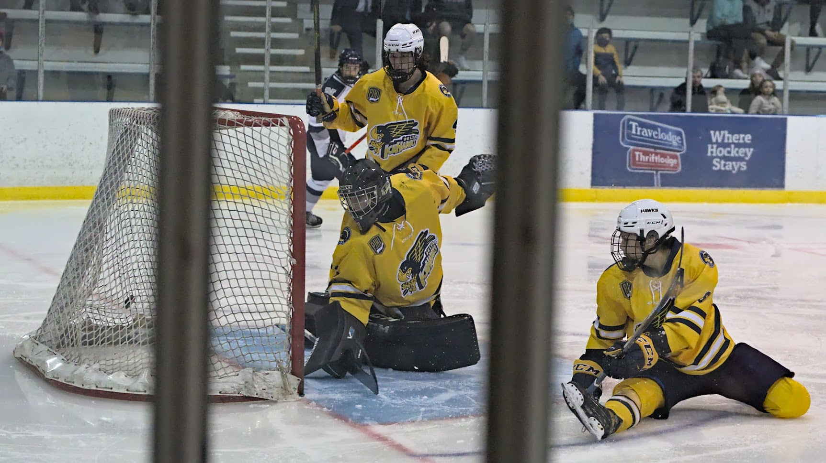
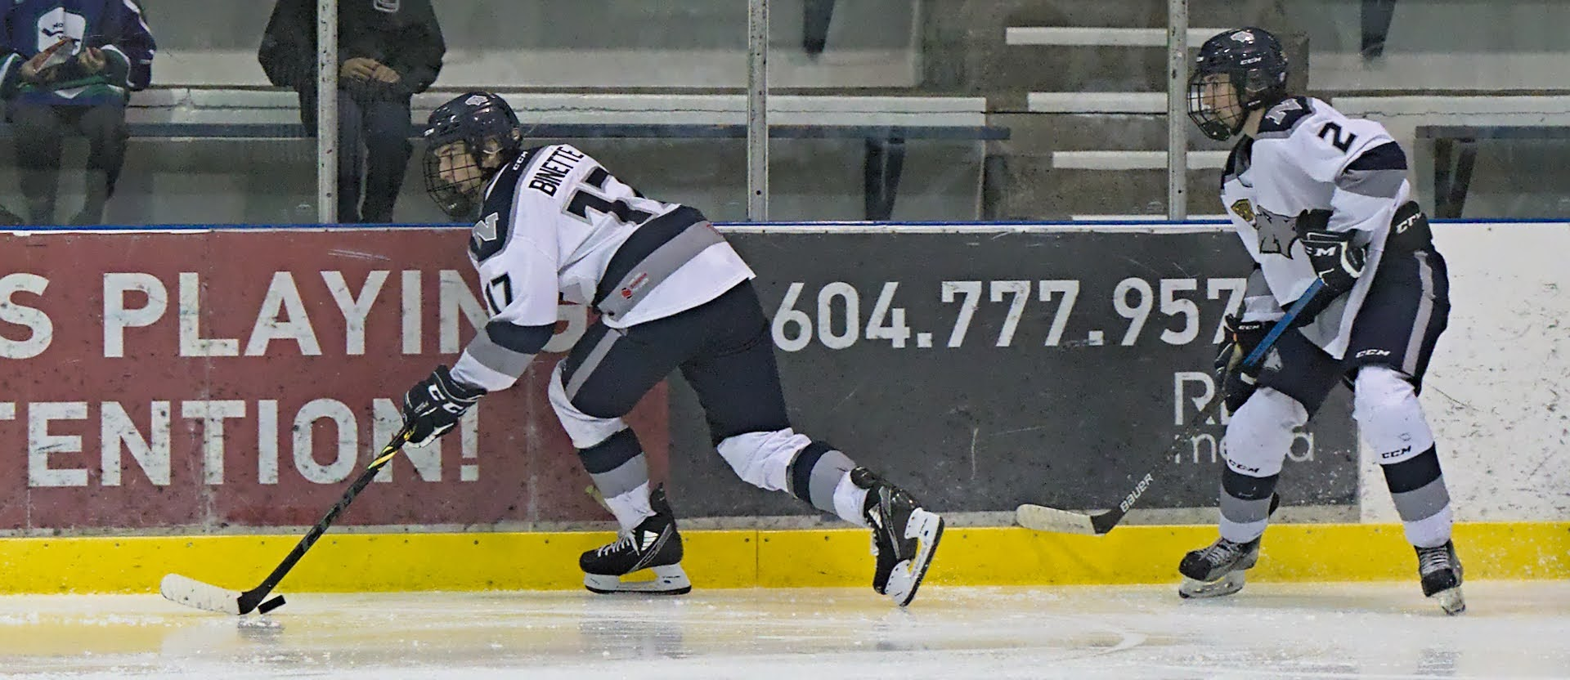
WOLF PACK GAME DAYS
GAMEDAY SPONSORS:
2
1
3
GAMENIGHT SPONSOR
$300
CONCOURSE ACTIVATION
$200
COMPANY PROMOS
$100
Sponsor a home game!
We will tailor any game night to fit
your company’s marketing objectives
through fan giveaway items,
special events, pre or post game
activities, and in-game contesting.
Set up a table in the concourse
area for giveaways, activities,
or PR for one game.
+PRIZES PROVIDED BY SPONSOR
Sponsor a contest at a
home game either on or off
of the ice. Options are also
available for the season.
CONTACT US FOR MORE DETAILS!

Slide 12
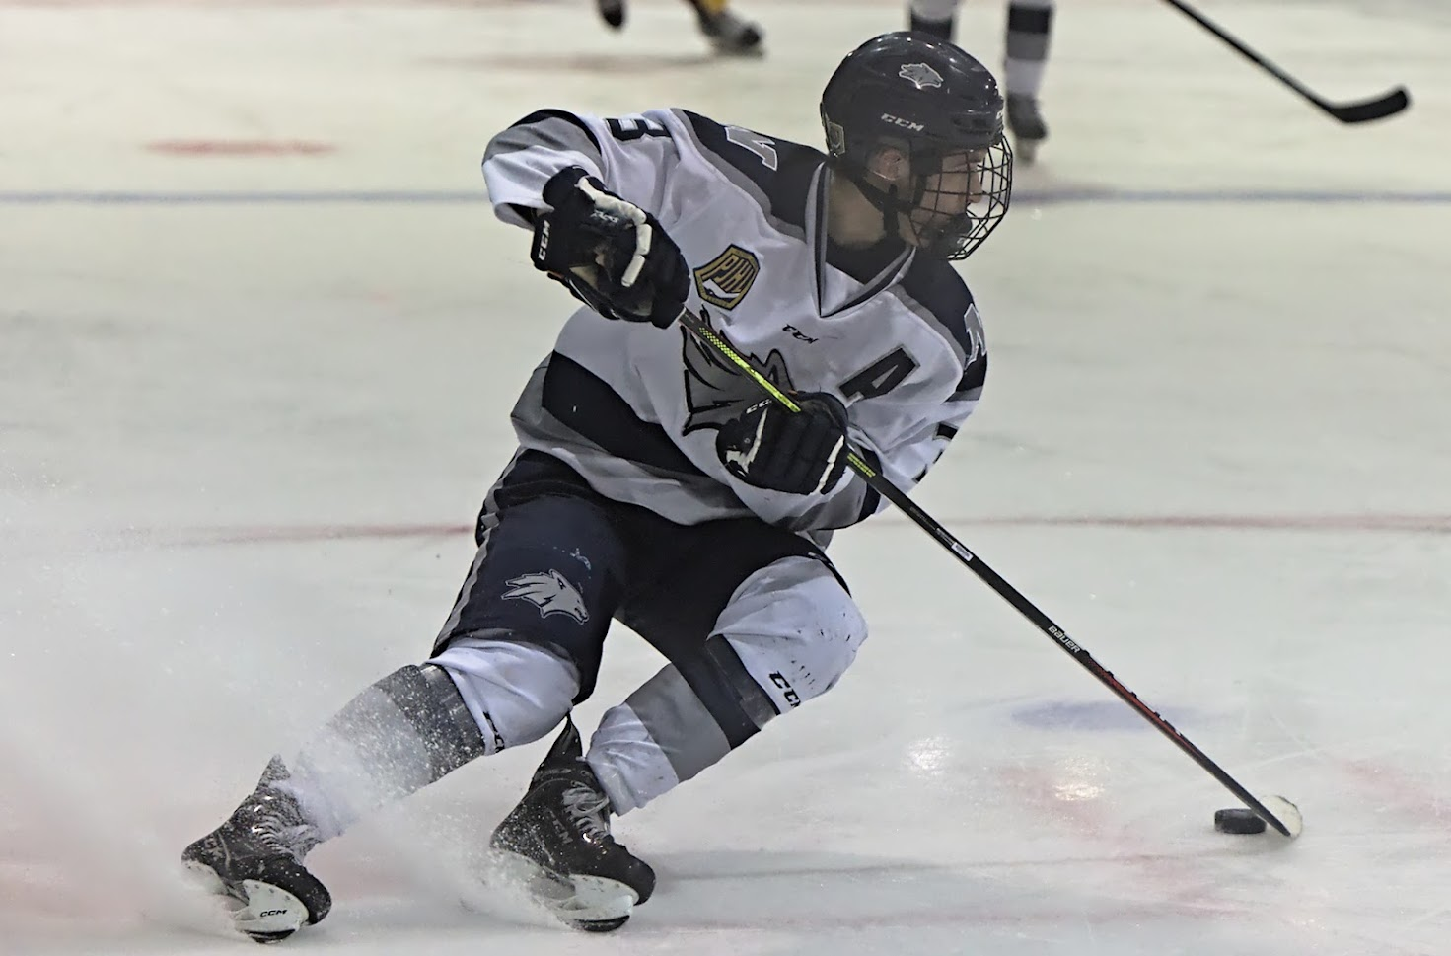
WOLF PACK GAME DAYS
PUBLIC ADDRESS ANNOUNCEMENTS:
3 STARS OF THE GAME $1000
STARTING LINEUP
$500
POWER PLAY / PENALTY KILL
$750
Sponsor the game’s 3 Stars of the game to have your company’s name announced at all home games. Plus, provide the 3 stars with a company prize.
+PRIZES PROVIDED BY SPONSOR
Sponsor the Wolf Pack’s power play and penalty kill to have your company’s name announced at all home games.
Sponsor the Wolf Pack’s starting lineup to have your company’s name announced at all home games.
CONTACT US FOR MORE DETAILS!
Notes:
Stars is a little pricey but if we can combine that with a sponsor in the NS News it may be attractive as it will pull eyes to the sponsor. Eg City Market Stars of the week
IGA Stars of the Week etc..

Slide 13
DIGITAL BRANDING

Slide 14
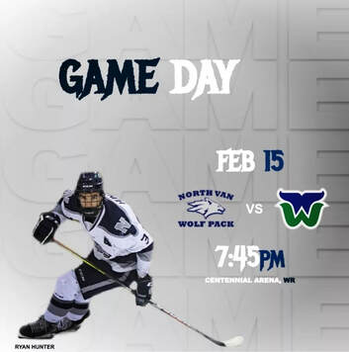
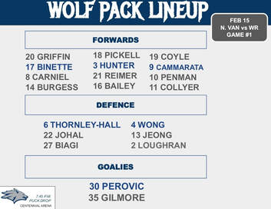
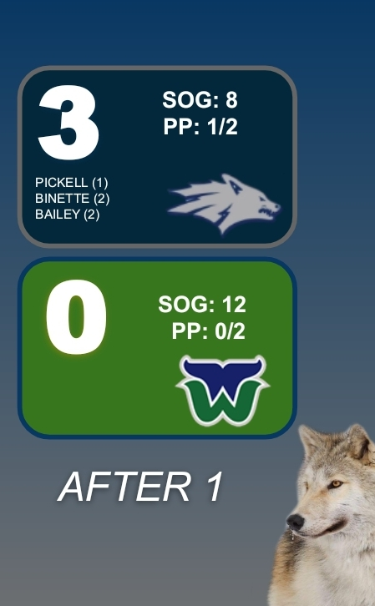
DIGITAL BRANDING
@northvanwolfpac
SOCIAL MEDIA GRAPHICS:
- GET ALL FOUR FOR $1000 -
GAMEDAY SPONSOR
$600
STARTING LINEUP
$500
INTERMISSION
$500
POST GAME SPONSOR
$500
Company logo displayed on all
gameday posts (home and away)
during regular season.
Company logo displayed on all
starting lineup posts
(home and away) during
regular season.
Company logo displayed on all
Intermission posts (home and
away) during regular season.
Company logo displayed on
all post-game posts
(home and away) during
regular season.
CONTACT US FOR MORE DETAILS!

Slide 15
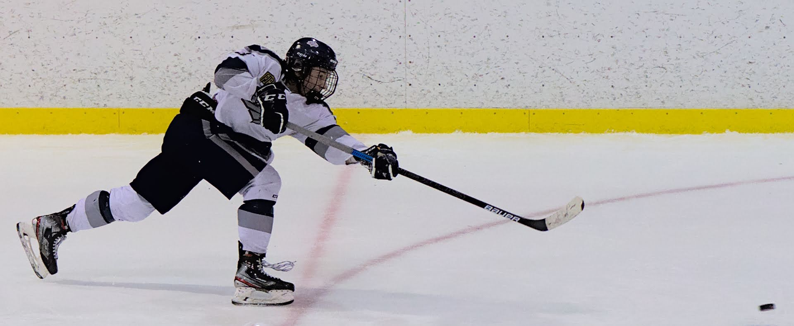
DIGITAL BRANDING
CONTACT US FOR MORE DETAILS!
SOCIAL MEDIA GRAPHICS:
HIGHLIGHT OF THE GAME $500
PLAYER PROFILE
$500
Company logo displayed on all
highlight of the game posts (home only)
during regular season. Video is posted on social media and played during home broadcasts.
Company logo displayed on all
player profile posts (home and away)
during regular season. Displayed on social media.

Slide 16
WEBSITE / BROADCAST
OPPORTUNITIES

Slide 17
WEBSITE / BROADCAST OPPORTUNITIES
LOGO ON WEBSITE
$500
AUDIO COMMERCIALS
$300
HOWLING ON AIR
$1000
Company logo displayed on website
with a link to your webpage.
Company name announced during all
Wolf Pack home games. Option to have multiple on-air mentions.
Be the presenting sponsor for all interviews done this season.
CONTACT US FOR MORE DETAILS!

Slide 18
OTHER OPPORTUNITIES

Slide 19
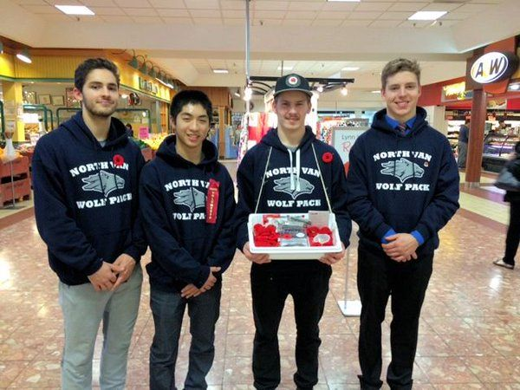
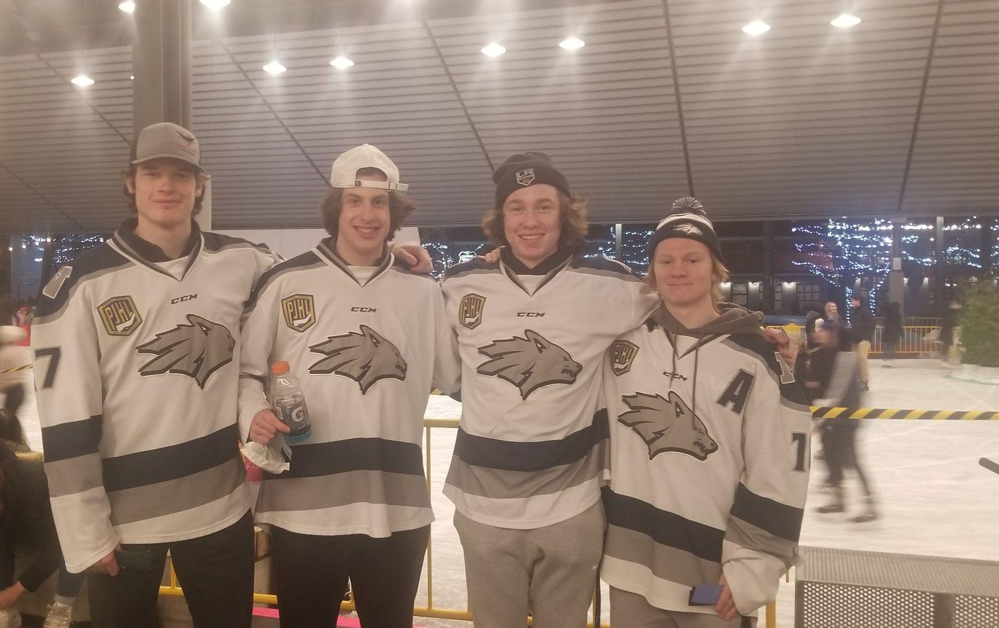
WOLVES IN THE COMMUNITY
SOCIAL MEDIA GRAPHICS:
WOLF PACK PLAYERS ATTEND MANY COMMUNITY EVENTS THROUGHOUT THE SEASON.
SPONSOR RECEIVES SOCIAL MEDIA GRAPHICS AS PRESENTING SPONSOR OF ALL COMMUNITY INITIATIVES.
COMMUNITY INITIATIVES
$550
FAMILY SERVICES OF THE NORTH SHORE
SALVATION ARMY
VANCOUVER FOOD BANK
SONS
CONTACT US FOR MORE DETAILS!

Slide 20
YEAR END PLAYER AWARDS
BE THE PRESENTING SPONSOR OF ONE YEAR END AWARD.
SPONSORSHIP INCLUDES PLAQUE ON TROPHY DISPLAYED YEAR-ROUND IN HARRY JEROME RECREATION CENTRE, SOCIAL MEDIA GRAPHIC, AND THE OPPORTUNITY TO PRESENT THE AWARD.
$600
CONTACT US FOR MORE DETAILS!

Slide 21
WHY PARTNER WITH US?
YOUR SUPPORT HELPS THE ORGANIZATION COVER COSTS ASSOCIATED WITH RUNNING A COMPETITIVE AND SUCCESSFUL JUNIOR HOCKEY TEAM, WHICH INCLUDES EXPENSES SUCH AS ICE TIME, EQUIPMENT, DRESSING ROOM UPGRADES, ATHLETE SCHOLARSHIPS, AND TRAVEL COSTS.
A GREAT HOCKEY TEAM IS MADE OF GREAT PEOPLE AND THE SUPPORT OF THEIR COMMUNITY. YOUR SUPPORT GIVES OUR PLAYERS THE OPPORTUNITY TO BECOME THE BEST ATHLETES AND PEOPLE THEY CAN BE BOTH ON, AND OFF THE ICE.
WE IN TURN PROMISE TO PROMOTE YOUR BUSINESS AND DRIVE OUR FOLLOWERS, PARENTS, FRIENDS, AND FAMILY TO SUPPORT YOU.

